Slide 1
Virtual Gateway architecture

Slide 2
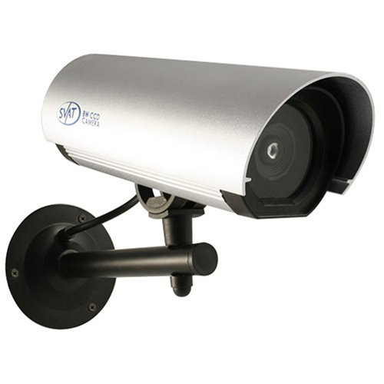
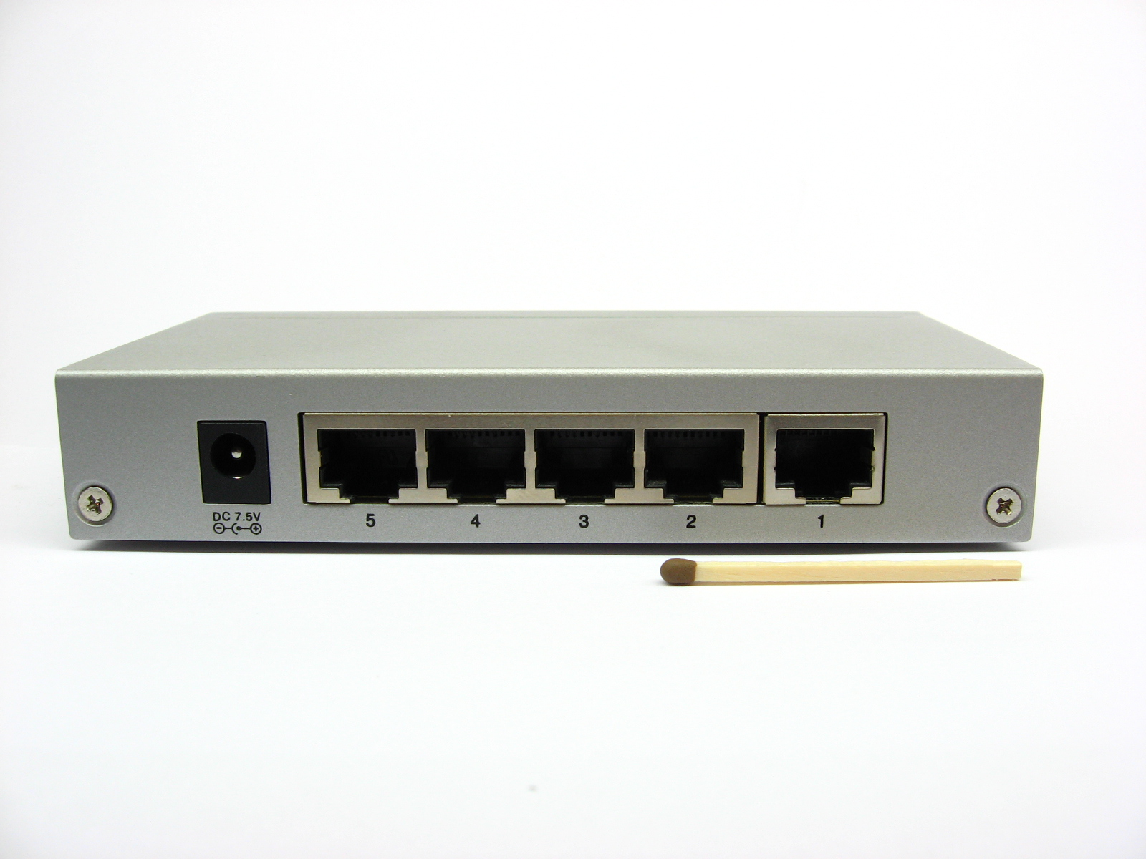
Server-less site with distributed bandwidth control
Cloud VMS

Slide 3
Network topology
Unicast ring for leader election and keep-alive checks
Bi-directional Unicast P2P for communication with elected leader node
Multicast for broadcasting presence
Outgoing HTTP for communication with internet
Node1
Node2
Node4
Node3
(current leader)
HTTP

Slide 4
Component view

Slide 5
Component decomposition (including simulated components)
Camera node process (multiple)
Multicast Listener Thread
Camera Node Manager
Bandwidth simulator process
(single)
Bandwidth simulator Client
Camera player
(simulation)
VMS simulator process
(single)
Unicast Listener Thread
VMS simulator Client

Slide 6
Use Cases

Slide 7
Initial discovery
Upon boot a node sends a multicast message containing its NodeId data structure
All nodes in the cluster receive the message triggering the following flow:
Add a node to the Node Array data structure (TreeMap <nodeName, NodeId>) This process populates all Node Array structures with the map of all nodes
Suspend bandwidth control activities
Detect node successor (thus creating the unicast ring topology)
Start a new leader election
Once a leader has been elected, resume bandwidth control activity

Slide 8
Discovery
Multicast Listener
Add Node
Leader Election
Node M
Node N
Boot
Broadcast NodeID to Group

Slide 9
Detection of lost node in cluster
Upon initialization each node sets up a keep-alive mechanism:
A recurring timer is set to send out a keep alive message to the node successor
A second (single activation) timer is set up by the first timer to wait for the message to return to the originator. If at the end of the timeout no message has been received then the node triggers a network rediscovery process
Once a network rediscovery has been triggered it resets the node array to zero and follows the addNode flow of initial discovery from that point onwards

Slide 10
Rediscovery upon detecting node failure
Node2
Transfer node 1 KA
Node3
Transfer node 1 KA
Node4
Transfer node 1 KA
Node5
Transfer node 1 KA
Node1 send keep alive
Node1
Node1
Rediscovery
Reset Network
Reset state
Broadcast self
Yes
No
Node1 KA
Loop
Complete?

Slide 11
Identification of a virtual site and communication with remote VMS
When a leader election round has been completed all nodes recognize the identity of the leader
The designated leader’s nodeArray contains the NodeId structures of all the nodes as well as the number of nodes
The leader creates a VMS client that communicates with the VMS on port 80 (or 8080) and informs it of the creation of a new virtual site
The VMS must be on a well known IP/port address

Slide 12
Bandwidth control I – Main algorithm
The purpose of the bw control algorithm is to ensure that bandwidth consumption is balanced between nodes
Every camera node supports several bandwidth/frame rate combinations. Each combination translates into a discrete bandwidth consumption quantity
All nodes contain a bw control array (cameraArray) with an entry for each node in the cluster. Only the elected leader actually uses it
Each entry in the array represents one of the possible bandwidth “hops” that node may perform.
As an example: If a node supports four bw combinations, its cameraArray value may be any integer value from 0 (highest) to 3 (lowest)

Slide 13
Bandwidth control I – Main algorithm
When a node detects it has excess bandwidth it sends a request to the leader to go up one “hop” in its bandwidth range
When a node detects it has bandwidth starvation it sends a request to the leader to go down one “hop” in its bandwidth range
Leader performs the following logic:
Upon an “Up” request it checks if any of the other cameraArray values is greater than the requesting node. If it is then the request is denied
Upon a “Down” request it checks if any of the other cameraArray values is Less than the requesting node. If it is then the request is denied
If the request is approved then the leader sends the approval to the requesting node and updates the node’s cameraArray value
The approval is in the form of the bandwidth index – the same integer value as is in the camera array. This values serves to select the matching resolution stream in the requesting node
If the request is approved the requesting node will adjust its bandwidth accordingly

Slide 14
Bandwidth control II – Detection of BW fluctuation
The site (cluster) upload bandwidth may be at a level that is between discrete hops. This will result in bw fluctuations where one node detects starvation, reduces bandwidth resulting in another node detecting bw excess, going up one “hop” and triggering starvation in one or more of the other nodes in the cluster.
Fluctuations are detected and as a result “Up” hops are suspended for a configurable amount of time.

Slide 15
CameraNode bandwidth control
Flow
Swarm Leader (node)
Bandwidth timer trigger
Camera has priority
Check BW
Change?
Approved?
Request
Change
Change
BW
Yes
No
No
Stop
Stop
Stop

Slide 16
Bandwidth control logic
Elected Leader Node
Node N
Unicast
Listener
Leader
Algo
Timer trigger
Check Flags
Check Bandwidth
Check Fluctuation
Change Bandwidth
request
Dispatcher
Check Priority
OK?
Unicast
Listener
Send response
Change Bandwidth
Dispatcher

Slide 17
Bandwidth control II – Detection of BW fluctuation
Fluctuation detection algorithm:
Only one camera at a time may be changed
Take sum of values of cameraArray before requested change
Take sum of values of proposed cameraArray after requested change
Take the difference between these two sums. It will be either +1 or -1
Populate an array of 2 elements representing current and previous differences
Take the sum of the array[2] of differences and create another array[2] of sum of differences (current and previous). A value of 0 indicates a direction change (extrema)
Take a sum of the sums. If it is zero then we have had two consecutive direction changes and we trigger a “fluctuation detected” event
A bandwidth “Up” change suppression flag is set and will only be released at the end of a configurable (long) timeout

Slide 18
Functional View

Slide 19
Camera Node class decomposition
CameraNode
NetworkDiscovery
LeaderAlgo
Dispatcher
NodeID (data class)
MulticastListenerThread
UnicastListenerThread
BandwidthSim
Client
VMS Sim
Client

Slide 20
CameraNode classes functional view I
CameraNode
MainLoop – responsible for running bandwidth control and detecting network changes
Bandwidth control methods
Leader Election methods
Network changes (add/remove nodes) methods
Handles communication with remote VMS
Simulation interface methods
NetworkDiscovery
Sets up ring topology through successor detection and communication
Sets up keep alive mechanism
Triggers network rediscovery upon lost nodes in the ring (message loop doesn’t complete)

Slide 21
CameraNode classes functional view II
LeaderAlgo
Executed only by Leader for all cameras in the cluster
Implements distributed bandwidth control algorithm
Implements bandwidth fluctuation detection algorithm
Dispatcher
Broadcast its identity (name, Inet address and port) upon boot, upon detection of new node and upon rediscovery after a node removal event
Implements generic sendMessage method (multicast and unicast)

Slide 22
CameraNode classes functional view III
NodeID
Data class containing basic node structure
Node fields:
InetAddress address;
int port;
String hostName;
String IP;
long hashCode;
int cameraId;
MulticastListener
Handles UDP comm. Setup
Listens to multicast port
Handles incoming multicast registration messages
Invokes CameraNode manager addNode method

Slide 23
CameraNode classes functional view IV
UnicastListener
Listens to unicast port
Handles incoming unicast messages for:
Leader Election
Bandwidth contro
Keep Alive mechanism
Invokes relevant CameraNode, NetworkDiscovery & LeaderAlgo methods:
startElectionMessage, setElectedMessage
requestLeaderBandwidthChange, sendBwResponseToRequestor, setCameraUpOrDownResponse
networkSetup.testDiscoveryLoop

